Slide 1







2024-2025 School Year
CLASSROOM
RULES
Coach Wilmer

Slide 2



01
Always be respectful to teacher, yourself, and others.
02
Remain quiet while others are talking.
MY 6
RULES
03
Listen and follow directions.
04
Stay away from your phones and Ms. Wilmer’s thermostat.
05
Help keep our classroom clean.
06
Remain seated unless given permission.

Slide 3



Ms. Wilmer’s zones:
Corner office area
Cabinet
Podium/stool
ZONES IN THE ROOM
Students’ zones:
Desk
Bookshelf
Announcement board
Learning Target/Success Criteria board

Slide 4


DAILY PROCEDURE
01
Come in and read agenda on board
Grab whatever is needed and sit down
Begin working on Bell Ringer
We will follow agenda
Wait for dismissal (everyone must be seated to be dismissed)
02
03
04
05

Slide 5






BATHROOM PASSES
  Given 4 per semester
  Must be signed prior to leaving classroom
  If saved, turn in at end of semester as a homework pass

Slide 6

A FEW REQUIREMENTS TO MAKE THE CLASSROOM RUN SMOOTHLY:

Slide 7




PLEASE BE ON TIME
WE START OUR CLASS ON TIME SO WE CAN END ON TIME.
If you are late, you will be marked tardy.
Please come in quietly and follow regular classroom routine.

Slide 8


PLEASE RAISE HAND TO SPEAK DURING INSTRUCTION

Slide 9
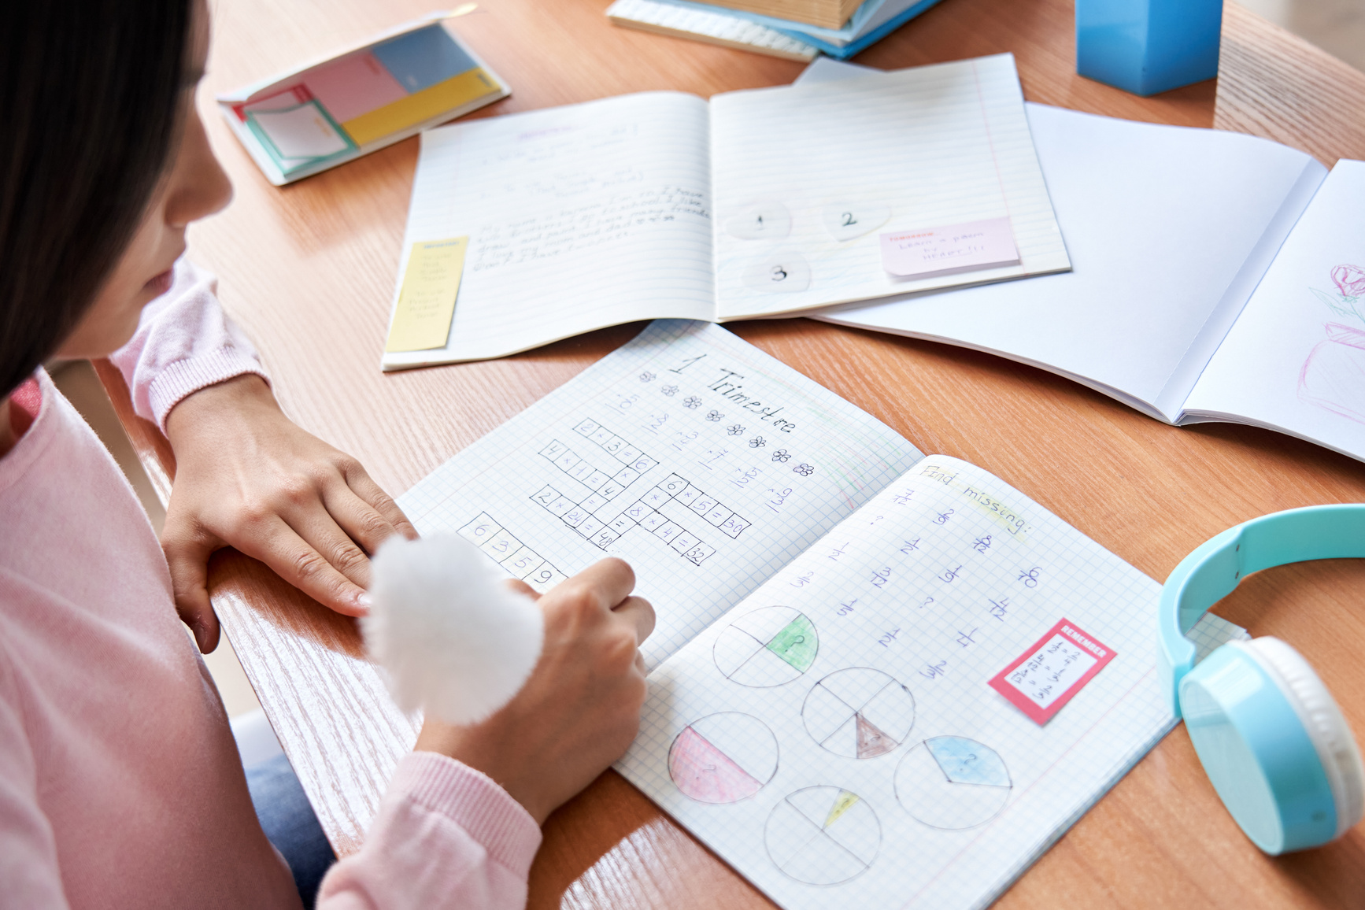



LATE WORK POLICY
YOU MUST MESSAGE ME ON REMIND OR SEND ME AN EMAIL IF YOU TURN IN WORK LATE
5 DAYS TO TURN IN LATE WORK
EVERY DAY LATE IS 5% OFF

Slide 10
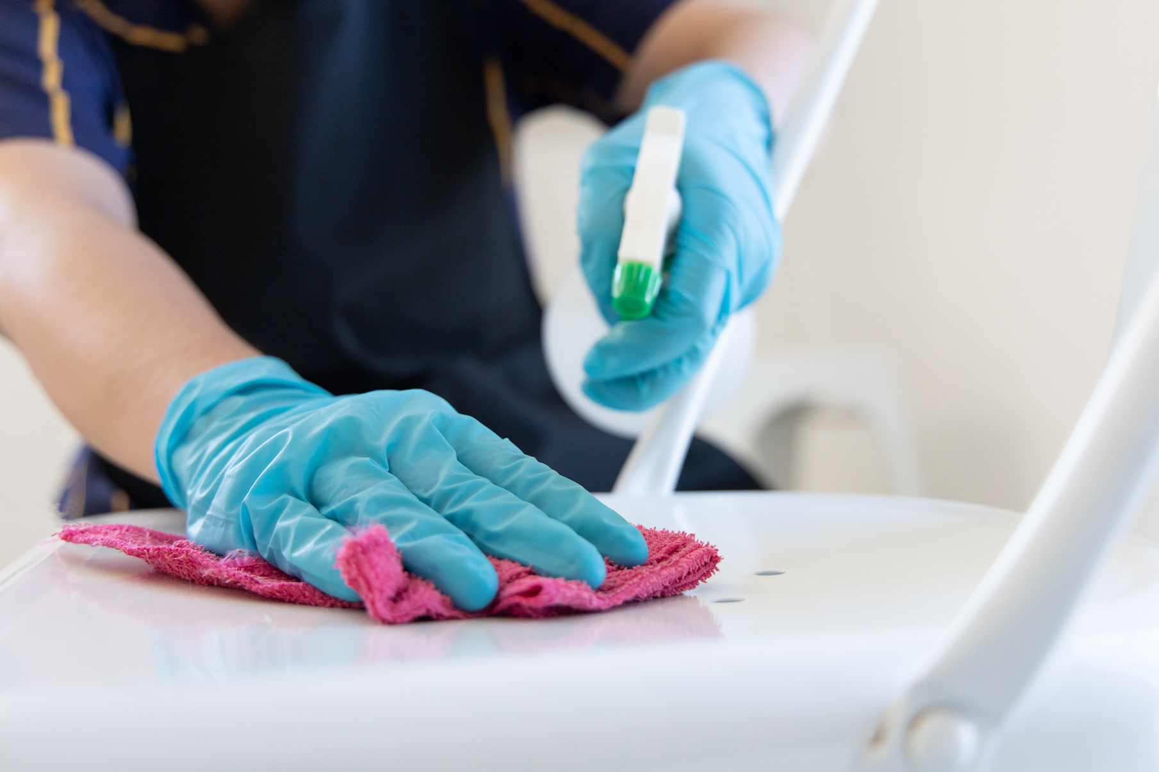

YOU MUST CLEAN UP YOUR AREA BEFORE LEAVING
PLEASE THROW AWAY ANY TRASH AND TAKE ALL OF YOUR BELONGINGS WITH YOU

Slide 11




01
Check class WAG
IF ABSENT
Week at a Glance on teacher's website
02
Check Canvas

Slide 12
DISCIPLINE PROCESS
1st Offense: Warning
2nd Offense: Parent is notified
3rd Offense: Detention
4th Offense: Counselor Referral
After 4th Offense: You will be referred to administration

Slide 13
THANK YOU
FOR LISTENING
Do you have any questions for me?

